Slide 1

Chapter 5:
Project Scope Management
Information Technology Project Management, Seventh Edition
Note: See the text itself for full citations.

Slide 2
讨论问题
1、项目范围管理涉及的6个主要过程
2、范围管理计划包括哪些信息？
3、收集需求的常用方法
4、制定工作分解结构（WBS）的方法
5、范围控制的目标
6、公司应遵循哪些最佳实践来避免出现主要的范围问题？
7、范围蔓延产生的原因？是否可以避免？如何预防范围蔓延的产生？

Slide 3
Learning Objectives
Understand the importance of good project scope management
Describe the process of planning scope management
Discuss methods for collecting and documenting requirements to meet stakeholder needs and expectations
Explain the scope definition process and describe the contents of a project scope statement
Discuss the process for creating a work breakdown structure using the analogy, top-down, bottom-up, and mind-mapping approaches

Slide 4
Learning Objectives
Explain the importance of validating scope and how it relates to defining and controlling scope
Understand the importance of controlling scope and approaches for preventing scope-related problems on information technology (IT) projects
Describe how software can assist in project scope management

Slide 5
What is Project Scope Management?
Scope refers to all the work involved in creating the products of the project and the processes used to create them
A deliverable is a product produced as part of a project, such as hardware or software, planning documents, or meeting minutes
Project scope management includes the processes involved in defining and controlling what is or is not included in a project

Slide 6
Project Scope Management Processes
Planning scope: determining how the project’s scope
and requirements will be managed
Collecting requirements: defining and documenting the features and functions of the products produced during the project as well as the processes used for creating them
Defining scope: reviewing the project charter, requirements documents, and organizational process assets to create a scope statement
Creating the WBS: subdividing the major project deliverables into smaller, more manageable components
Validating scope: formalizing acceptance of the project deliverables
Controlling scope: controlling changes to project scope throughout the life of the project

Slide 7
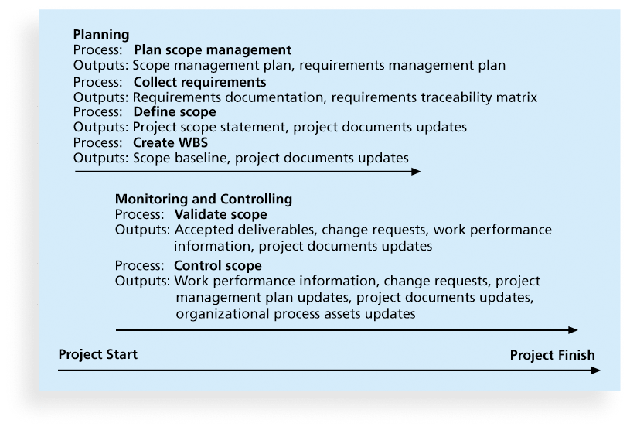
Figure 5-1. Project Scope Management Summary

Slide 8
Planning Scope Management
The project team uses expert judgment and meetings to develop two important outputs: the scope management plan and the requirements management plan
The scope management plan is a subsidiary part of the project management plan

Slide 9
Scope Management Plan Contents
How to prepare a detailed project scope statement
How to create a WBS
How to maintain and approve the WBS
How to obtain formal acceptance of the completed project deliverables
How to control requests for changes to the project scope

Slide 10
Requirements Management Plan
The PMBOK® Guide, Fifth Edition, describes requirements as “conditions or capabilities that must be met by the project or present in the product, service, or result to satisfy an agreement or other formally imposed specification”
The requirements management plan documents how project requirements will be analyzed, documented, and managed

Slide 11
Collecting Requirements
For some IT projects, it is helpful to divide requirements development into categories called elicitation, analysis, specification, and validation
It is important to use an iterative approach to defining requirements since they are often unclear early in a project

Slide 12
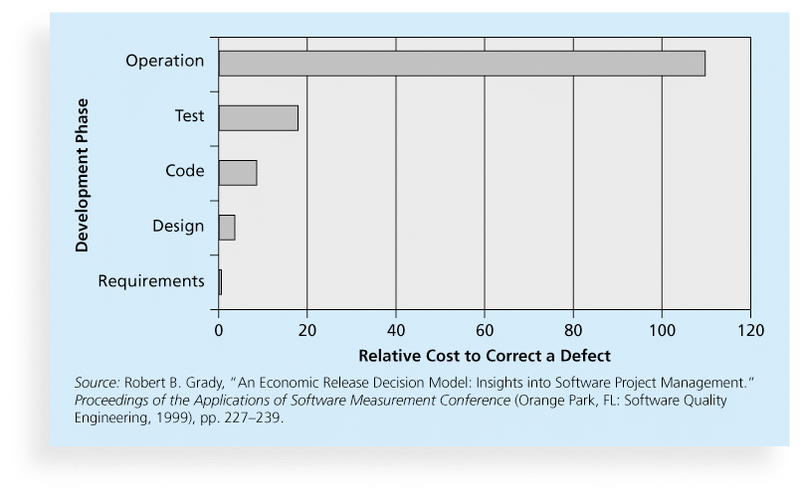
Figure 5-2. Relative Cost to Correct a Software Requirement Defect

Slide 13
Methods for Collecting Requirements
Interviewing
Focus groups and facilitated workshops
Using group creativity and decision-making techniques
Questionnaires and surveys
Observation
Prototyping
Benchmarking, or generating ideas by comparing specific project practices or product characteristics to those of other projects or products inside or outside the performing organization, can also be used to collect requirements

Slide 14
Statistics on Requirements for
Software Projects (2011 Survey)*
Eighty-eight percent of the software projects involved enhancing existing products instead of creating new ones
Eighty-six percent of respondents said that customer satisfaction was the most important metric for measuring the success of development projects
Eighty-three percent of software development teams still use Microsoft Office applications such as Word and Excel as their main tools to communicate requirements
*John Simpson, “2011: The State of Requirements Management” (2011).

Slide 15
What Went Right?
Genesys Telecommunications Laboratories uses Accept software, a product planning and innovation management application and winner of the Excellence in Product Management Award from 2006–2008
Accept helps them instill a consistent, repeatable, and predictable process for new product definition and development
They can define what information comprises a requirement and enforce discipline around that process

Slide 16
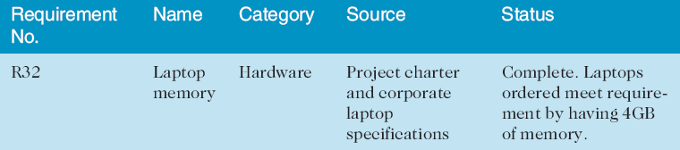
Requirements Traceability Matrix
A requirements traceability matrix (RTM) is a table that lists requirements, various attributes of each requirement, and the status of the requirements to ensure that all requirements are addressed
Table 5-1. Sample entry in an RTM

Slide 17
Defining Scope
Project scope statements should include at least a product scope description, product user acceptance criteria, and detailed information on all project deliverables. It is also helpful to document other scope-related information, such as the project boundaries, constraints, and assumptions. The project scope statement should also reference supporting documents, such as product specifications
As time progresses, the scope of a project should become more clear and specific

Slide 18
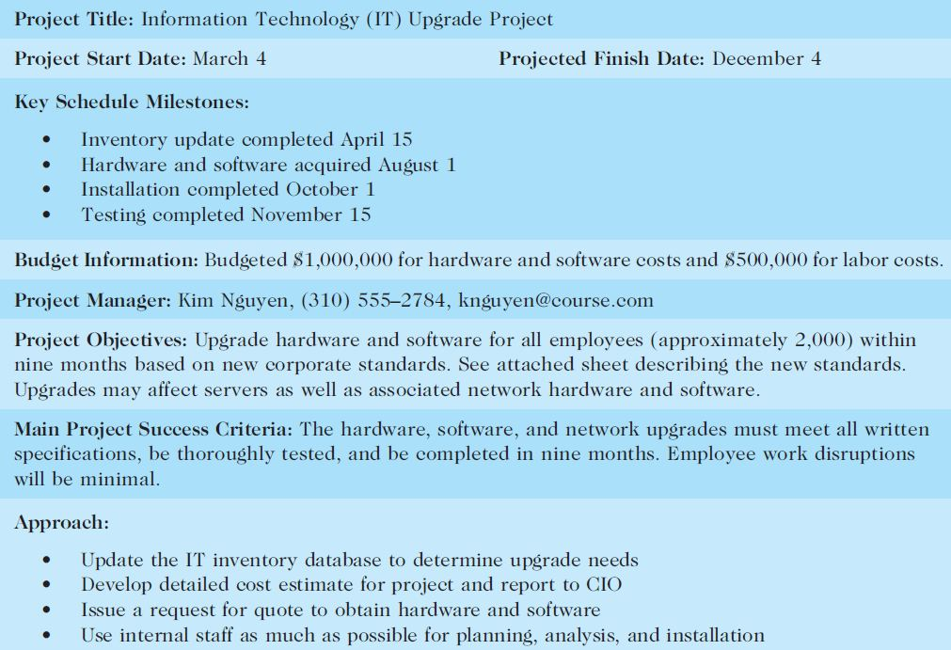
Table 5-2. Sample Project Charter (partial)

Slide 19
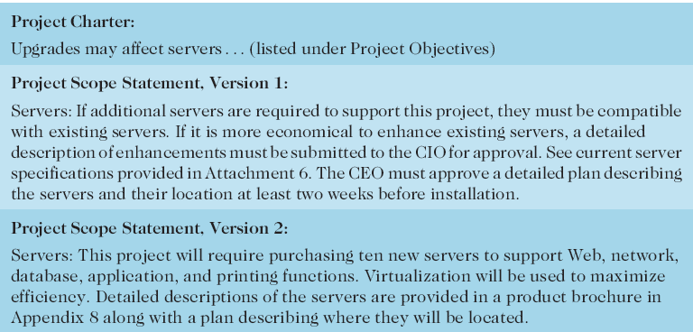
Table 5-3: Further Defining Project Scope

Slide 20
Media Snapshot
Many people enjoy watching television shows like Trading Spaces, where participants have two days and $1,000 to update a room in their neighbor’s house. Since the time and cost are set, it’s the scope that has the most flexibility
Although most homeowners are very happy with work done on the show, some are obviously disappointed. Part of agreeing to be on the show includes signing a release statement acknowledging that you will accept whatever work has been done
Too bad you can’t get sponsors for most projects to sign a similar release form. It would make project scope management much easier!

Slide 21
Creating the Work Breakdown Structure (WBS)
A WBS is a deliverable-oriented grouping of the work involved in a project that defines the total scope of the project
WBS is a foundation document that provides the basis for planning and managing project schedules, costs, resources, and changes
Decomposition is subdividing project deliverables into smaller pieces
A work package is a task at the lowest level of the WBS
The scope baseline includes the approved project scope statement and its associated WBS and WBS dictionary

Slide 22
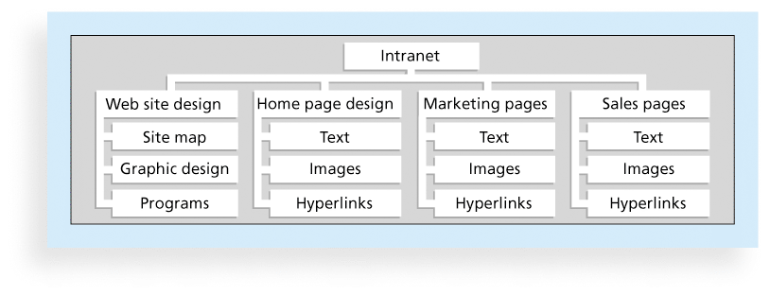
Figure 5-3. Sample Intranet WBS
Organized by Product

Slide 23
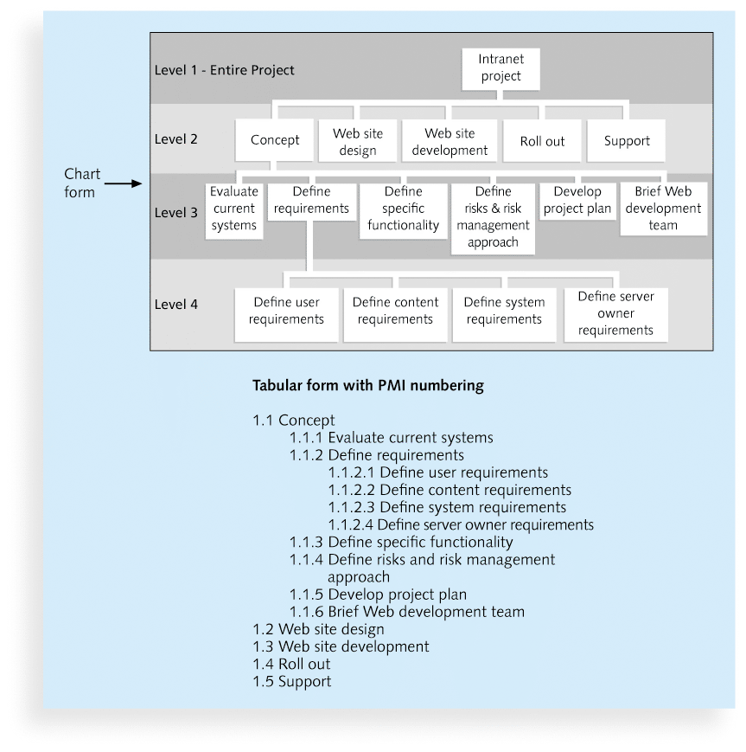
Figure 5-4. Sample Intranet WBS
Organized by Phase

Slide 24
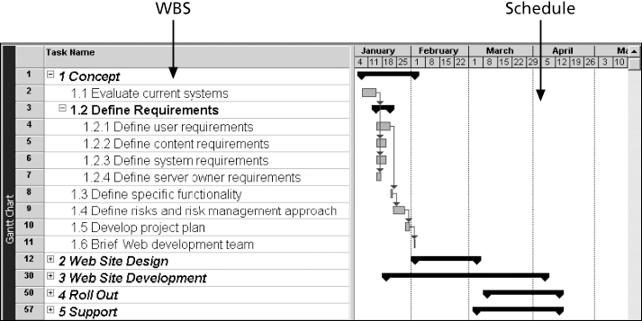
Figure 5-5. Intranet WBS and Gantt Chart in Microsoft Project

Slide 25
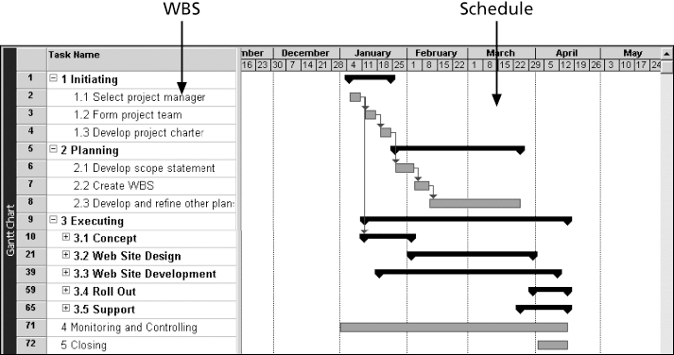
Figure 5-6. Intranet Gantt Chart Organized by Project Management Process Groups

Slide 26
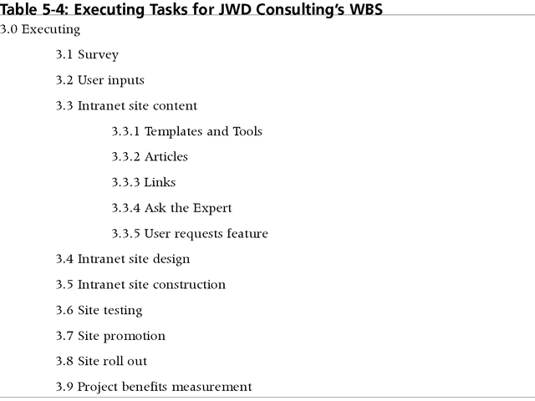
Table 5-4: Executing Tasks for JWD Consulting’s WBS

Slide 27
Approaches to Developing WBSs
Using guidelines: Some organizations, like the DOD, provide guidelines for preparing WBSs
The analogy approach: Review WBSs of similar projects and tailor to your project
The top-down approach: Start with the largest items of the project and break them down
The bottom-up approach: Start with the specific tasks and roll them up
Mind-mapping approach: Mind mapping is a technique that uses branches radiating out from a core idea to structure thoughts and ideas

Slide 28
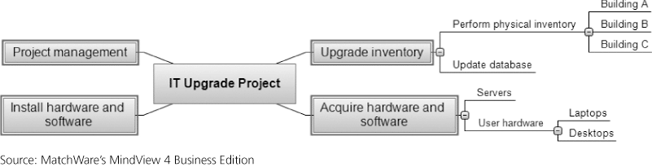
Figure 5-7. Sample Mind-Mapping Approach for Creating a WBS

Slide 29
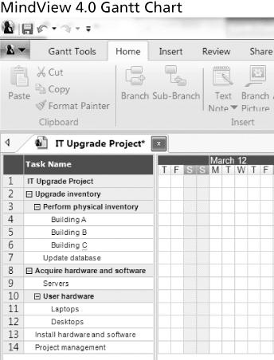
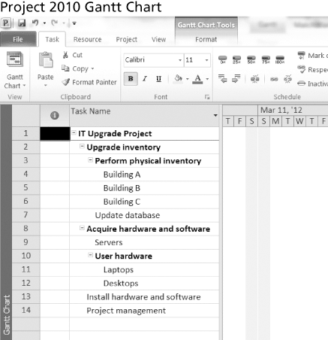
Figure 5-8. Gantt Charts With WBS Generated From a Mind Map

Slide 30
The WBS Dictionary and Scope Baseline
Many WBS tasks are vague and must be explained more so people know what to do and can estimate how long it will take and what it will cost to do the work
A WBS dictionary is a document that describes detailed information about each WBS item

Slide 31
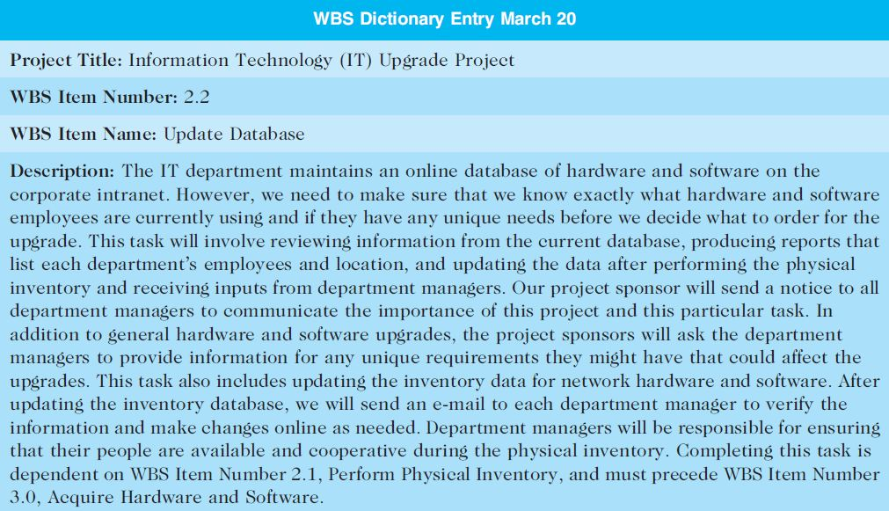
Table 5-5. Sample WBS Dictionary Entry

Slide 32
Advice for Creating a WBS and WBS Dictionary
A unit of work should appear at only one place in the WBS.
The work content of a WBS item is the sum of the WBS items below it
A WBS item is the responsibility of only one individual, even though many people may be working on it
The WBS must be consistent with the way in which work is actually going to be performed; it should serve the project team first, and other purposes only if practical

Slide 33
Advice for Creating a WBS and WBS Dictionary (cont’d)
Project team members should be involved in developing the WBS to ensure consistency and buy-in
Each WBS item must be documented in a WBS dictionary to ensure accurate understanding of the scope of work included and not included in that item
The WBS must be a flexible tool to accommodate inevitable changes while properly maintaining control of the work content in the project according to the scope statement

Slide 34
Validating Scope
It is very difficult to create a good scope statement and WBS for a project
It is even more difficult to verify project scope and minimize scope changes
Scope validation involves formal acceptance of the completed project deliverables
Acceptance is often achieved by a customer inspection and then sign-off on key deliverables

Slide 35
What Went Wrong?
A project scope that is too broad and grandiose can cause severe problems
  Scope creep and an overemphasis on technology for technology’s sake resulted in the bankruptcy of a large pharmaceutical firm, Texas-based FoxMeyer Drug
  In 2001, McDonald’s fast-food chain initiated a project to create an intranet that would connect its headquarters with all of its restaurants to provide detailed operational information in real time. After spending $170 million on consultants and initial implementation planning, McDonald’s realized that the project was too much to handle and terminated it

Slide 36
Global Issues
Many countries have had difficulties controlling the scope of large projects, especially those that involve advanced technologies and many different users
For example, the state government of Victoria, Australia, has a Web site for its public transportation smart card at www.myki.com.au.
There were many problems in developing and implementing the smart card

Slide 37
Controlling Scope
Scope control involves controlling changes to the project scope
Goals of scope control are to
  influence the factors that cause scope changes
  assure changes are processed according to procedures developed as part of integrated change control, and
  manage changes when they occur
Variance is the difference between planned and actual performance

Slide 38
Best Practices for Avoiding Scope Problems
1. Keep the scope realistic. Don’t make projects so large that they can’t be completed. Break large projects down into a series of smaller ones
2. Involve users in project scope management. Assign key users to the project team and give them ownership of requirements definition and scope verification
3. Use off-the-shelf hardware and software whenever possible. Many IT people enjoy using the latest and greatest technology, but business needs, not technology trends, must take priority
4. Follow good project management processes. As described in this chapter and others, there are well-defined processes for managing project scope and others aspects of projects

Slide 39
Suggestions for Improving User Input
Develop a good project selection process and insist that sponsors are from the user organization
Have users on the project team in important roles
Have regular meetings with defined agendas, and have users sign off on key deliverables presented at meetings
Deliver something to users and sponsors on a regular basis
Don’t promise to deliver when you know you can’t
Co-locate users with developers

Slide 40
Suggestions for Reducing Incomplete and Changing Requirements
Develop and follow a requirements management process
Use techniques such as prototyping, use case modeling, and JAD to get more user involvement
Put requirements in writing and keep them current
Create a requirements management database for documenting and controlling requirements

Slide 41
Suggestions for Reducing Incomplete and Changing Requirements (cont’d)
Provide adequate testing and conduct testing throughout the project life cycle
Review changes from a systems perspective
Emphasize completion dates to help focus on what’s most important
Allocate resources specifically for handling change requests/enhancements like NWA did with ResNet

Slide 42
Using Software to Assist in Project Scope Management
Word-processing software helps create several scope-related documents
Spreadsheets help to perform financial calculations, weighed scoring models, and develop charts and graphs
Communication software like e-mail and the Web help clarify and communicate scope information
Project management software helps in creating a WBS, the basis for tasks on a Gantt chart
Specialized software is available to assist in project scope management

Slide 43
Chapter Summary
Project scope management includes the processes required to ensure that the project addresses all the work required, and only the work required, to complete the project successfully
Main processes include
  Define scope management
  Collect requirements
  Define scope
  Create WBS
  Validate scope
  Control scope

Slide 44
练习
1、___是指包括生产项目产品及应用生产产品的过程的所有工作。
A.可交付成果
B.里程碑
C.范围
D.产品开发
‎2、在需求收集阶段，___成本最高且耗时最长。
A.访谈
B.焦点小组会议
C.问卷调查
D.观察

Slide 45
练习
3、___是一个项目中以可交付成果为导向的涉及所有工作的一种分组，它定义了项目的整体范围。
A.范围说明书
B.WBS
C.WBS字典
D.工作包
‎4、创建WBS时，___是以非线性形式将想法写出或画出。
A.自上而下法
B.自下而上法
C.类比法
D.思维导图法

Slide 46
练习
5、假定你有一个项目，该项目的主要条目为计划、分析、设计、测试。那么这些事项位于WBS中的层级___。
A.0
B.1
C.2
D.3
6、___下列哪一项不是能够避免IT项目范围问题的最佳实践。
A.范围要符合实际
B.如果可能，利用现有的硬件和软件
C.遵循有效的项目管理过程
D.不要太多的用户参与范围管理

Slide 47
练习
7、为什么麦当劳终止了一个已经投资1.7亿美元的大型项目？
A.该公司发现了一个更好的技术
B.该公司决定外包工作
C.范围太广而不能处理
D.政府要求促使了项目被废除
8、范围___通常是通过客户检查来完成的，然后以关键的可交付成果收尾。
A.核实
B.验证
C.完成
D.结束淘汰

Slide 48
练习
9、下面___不是改善用户输入的建议。
A.为IT项目开发一个有效的项目选择过程
B.用户参与项目团队
C.用户与开发人员共处一处
D.仅在需要时开会而非定期
10、项目管理软件可以帮助构建___，它可为制作甘特图、分配资源以及分摊成本打下基础。
A.项目计划
B.进度
C.WBS
D.可交付成果

Slide 49
讨论问题
1、项目范围管理涉及的6个主要过程
2、范围管理计划包括哪些信息？
3、收集需求的常用方法
4、制定工作分解结构（WBS）的方法
5、范围控制的目标
6、公司应遵循哪些最佳实践来避免出现主要的范围问题？
7、范围蔓延产生的原因？是否可以避免？如何预防范围蔓延的产生？

Slide 50
讨论问题
1、项目范围管理涉及的6个主要过程
制定范围管理计划
收集需求
定义范围
创建工作分解结构
验证范围
控制范围

Slide 51
讨论问题
2、范围管理计划包括哪些信息？
如何准备一个详细的范围说明书
如何创建一个WBS
如何维护和批准WBS
如何获得正式验收已完成的项目可交付成果
如何控制项目范围变更的请求

Slide 52
讨论问题
3、收集需求的常用方法
与项目干系人一对一访谈
使用焦点小组会议、引导式研讨会、群体创新和决策技术
问卷调查法
观察法
原型法和文档分析法
基准测试

Slide 53
讨论问题
4、制定工作分解结构（WBS）的方法
使用指南
类比法
自上而下法
自下而上法
思维导图法

Slide 54
讨论问题
5、范围控制的目标
影响那些导致范围变更的因素
确保变更是按照综合变更控制中开发的过程来处理的
当变更出现的时候对其进行管理

Slide 55
讨论问题
6、公司应遵循哪些最佳实践来避免出现主要的范围问题？
范围要符合实际
使用户参与项目范围管理
如果可能，使用现有的硬件和软件
遵守良好的项目管理过程

Slide 56
讨论问题
7、范围蔓延产生的原因？是否可以避免？如何预防范围蔓延的产生？
1）确保自己明白项目的范围；
2）了解你自己认为重要的东西和项目主管认为重要的东西；
3）定义你的项目发布目标并让项目主管同意它们；
4）把经过同意的项目发布目标细化成具体的工作要求；
5）将项目分解成大的和小的里程碑并编写一个大概的项目时间表以获得项目主管的同意；
6）一旦时间表已经创立，那么你就需要使用一个 PERT图表或者任务分配表来分配资源和确定项目的关键路径；
7）意识到会出现项目范围蔓延。尽早填写项目范围改变要求表格并在开发的过程中说服项目主管。

